Slide 1
HUMAN DETECTION USING a region-proposal INJECTION LAYER IN YOLO nano model
Members:
Jelin Raphael Akkara – 2072064
Kiamehr Javid - 2084294
Davide Checchia - 2078232

Slide 2
OUTLINE
INTRODUCING THE PROBLEM
DATASET AND PREPROCESSING
RESULTS
CONCLUSION

Slide 3
i. Introducing the problem
DEFINING THE OBJECTIVE
PREVIOUS RELATED WORKS
THE YOLO MODEL

Slide 4
Defining the objective
Improving performance of YOLOv8n in the task for detecting Small Humans
Small Humans: Occluded or Far-away persons in the image.

Slide 5
Related work
Histogram of Gradients (HoG): Early detection model using a sliding window approach to calculate gradient histograms for each pixel.
Region-based Convolutional Neural Network (R-CNN): Module-based architecture with Region Proposal CNN paired with Feature Extraction architectures. The extracted features were classified into one of the class labels.

Slide 6
The yolo model
Reframes object detection as a regression problem, enabling end-to-end training
Extremely Fast: 155 frames per second, while providing a higher accuracy than other real-time models
Highly Influential: The 10th version has been released in less than 10 years since publication

Slide 7
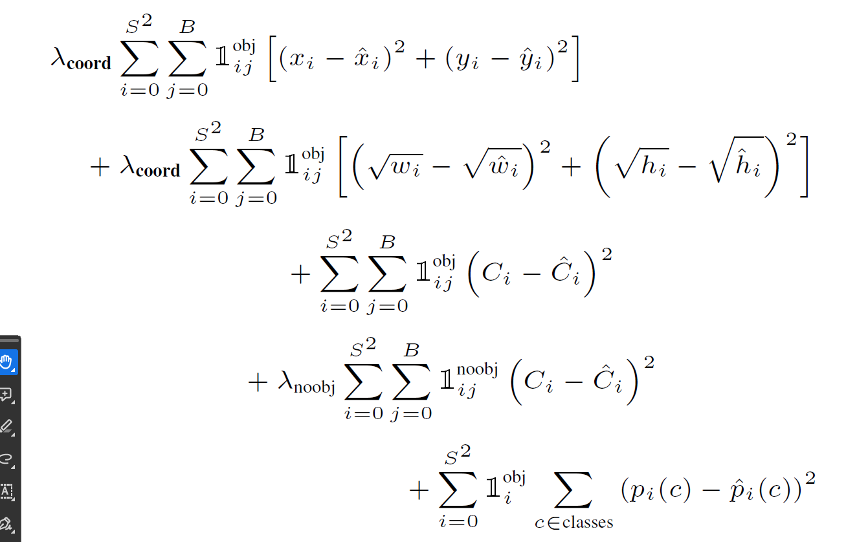
The yolo model
Image Grid: We grid the image (SxS) and assign certain cells to correspond to the objects present in the image.
Confidence Score: Reflects how confident the model is that the box contains an object (Pr(Object)) and how accurate it thinks its prediction is (IoU).
Bounding Box: Made of values, (x, y, w, h, C).
Final Tensor shape: S x S x (B * 5 + C)

Slide 8
The yolo model
YOLOv1: Introduced regression-based loss for object detection.
YOLOv2: Introduced Anchor boxes and performed multi-scale training on different image sizes.
YOLOv3: Introduced Residual Blocks, Feature Pyramid Networks (FPNs), and used binary cross entropy loss for class predictions.
YOLOv4: Introduced CSPNet, PANet, and employed Mosaic data augmentation, CIoU Loss
YOLOv5: Community driven release for easier accessibility.
YOLOv6: Anchor-free detection
YOLOv7: Extended architecture,
YOLOv8: More unified and streamlined architecture

Slide 9
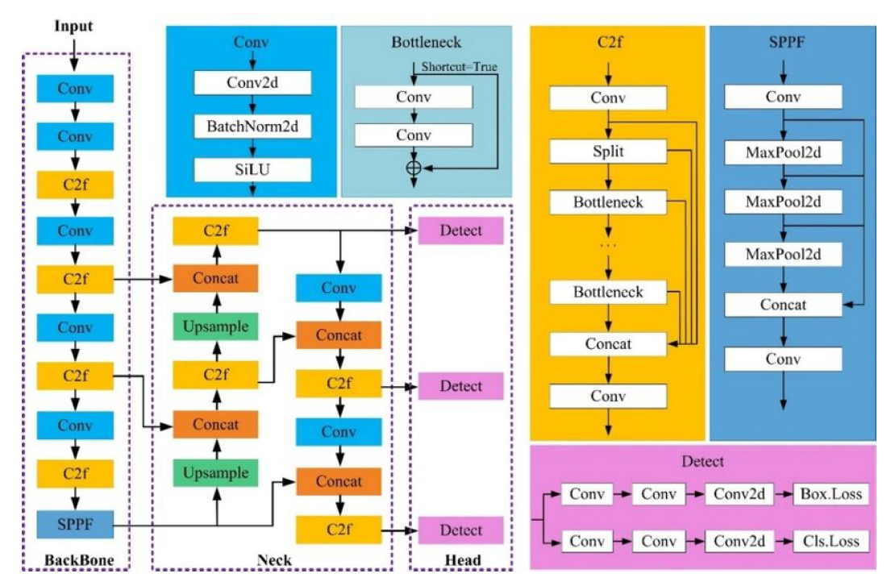
The yolo model

Slide 10
iI. DATASET AND PREPROCESSING
CHOOSING THE DATASET
PREPROCESSING THE DATASET
INJECTING A SHARP-BLOB ENHANCER

Slide 11
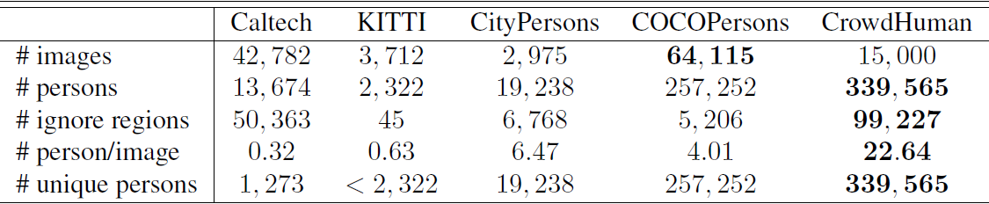
Choosing the dataset: crowdhuman
Contains 15000, 4370 and 5000 images for training, validation, and testing, respectively.
Of these, we choose 1000 training and 500 validation samples.

Slide 12
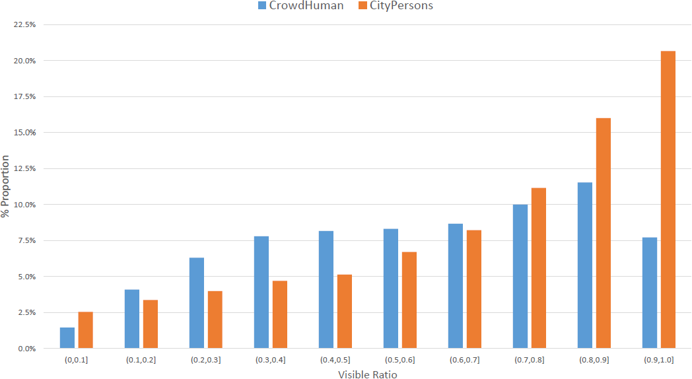
Choosing the dataset: crowdhuman

Slide 13
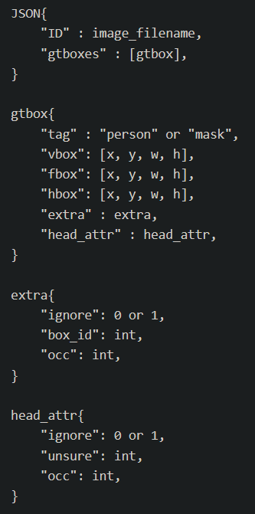
Choosing the dataset: crowdhuman
Dataset Format
Annotations: Saved as an .odgt file (each line is a JSON)
Image: Saved as .jpeg, with each filename corresponding to a unique ID
In the annotations, each image ID has three Bounding Boxes:
Head Box
Visible Body Box
Full Body Box

Slide 14
preprocessing the dataset: converting annotations to yolo format
We choose Visible Body Bounding Box, as the model is most comfortable with these.
Assign label 0 to persons (just like in the trained dataset)
Convert the (x_BottomLeft, y_BottomLeft) to (x_Center, y_Center), and normalize everything with respect to the whole image dimensions

Slide 15
preprocessing the dataset: preparing the small human dataset
Small Human: A person that is occluded or far-away in the image
We filter the data to images with only small human annotations. We do this using two thresholds:
Log Area threshold: Defines what size the annotation should be. We set the threshold to be a 50x50 grid on a 640x640 image.
Count threshold: This selects images with at least 10 small humans.
We delete all the large annotations and only keep the small ones
Prepare a test set with 1000 images

Slide 16
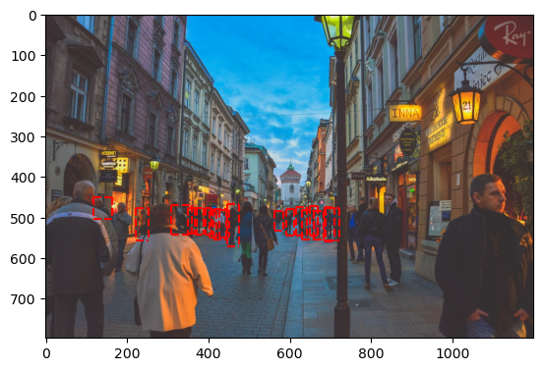
preprocessing the dataset: preparing the small human dataset

Slide 17
Injecting a sharp-blob enhancer
Key Idea: Provide region proposals using a simple blob detection algorithm by sharpening the proposed blob regions
Blob Detection: We use the SimpleBlobDetector method from OpenCV. It detects blobs using thresholding and obtaining binary images, and filtering out based on the parameters we set.
minArea = 200: This measures how much pixel area should be covered by the blob.
minCircularity = 0.4: This measures how much deviation there is from a circle.
minInertia = 0.01: This measures how elongated the blob is. It filters out lines.

Slide 18
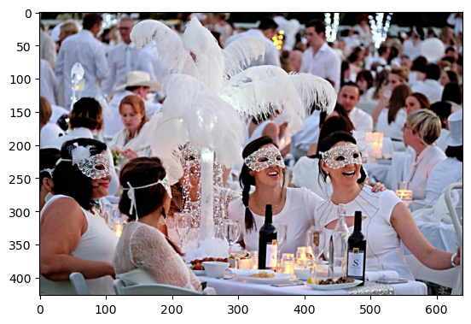
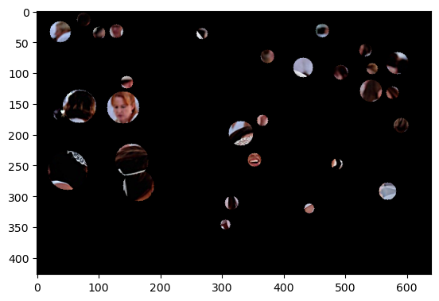
Injecting a sharp-blob enhancer

Slide 19

Injecting a sharp-blob enhancer: enhancer
Sharpening: The detected blob regions are sharpened
Augmenting: The sharpened blob regions are then superimposed on to the original image

Slide 20
III. RESULTS
RELEVANT METRICS
OPTIMIZATION OF PARAMETERS
MODEL COMPARISONS

Slide 21
Relevant metrics
mAP50, mAP50-95
Average Precision (AP): Area under the Precision-Recall Curve, varying across class confidence thresholds
mean Average Precision (mAP): Mean of AP across all classes
mAP50, mAP50-95: mAP with a (fixed) IoU threshold (varying)

Slide 22
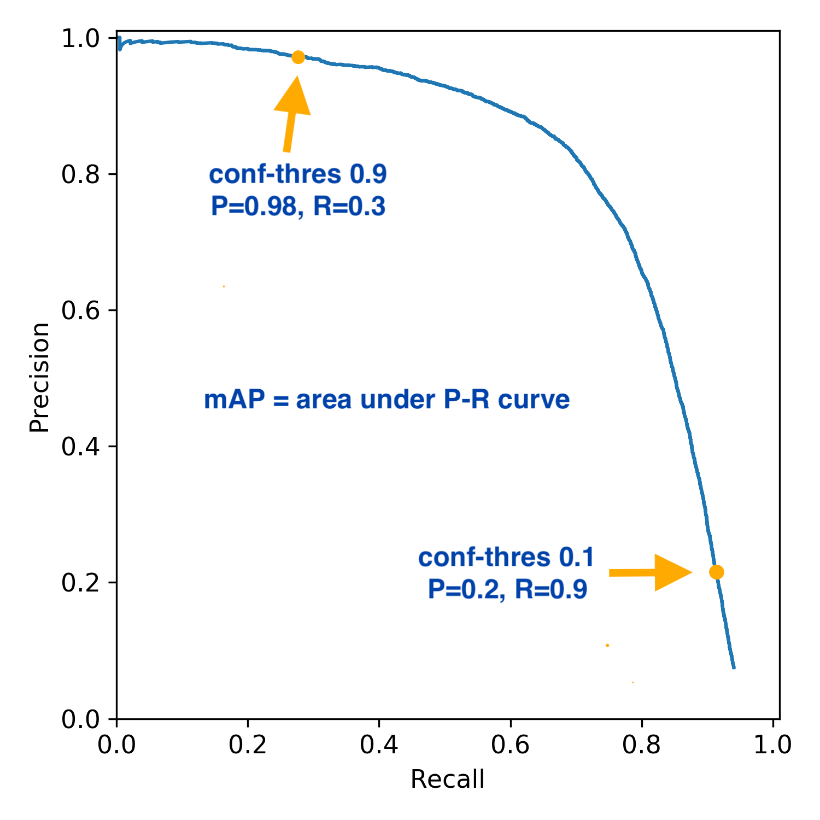
Relevant metrics

Slide 23
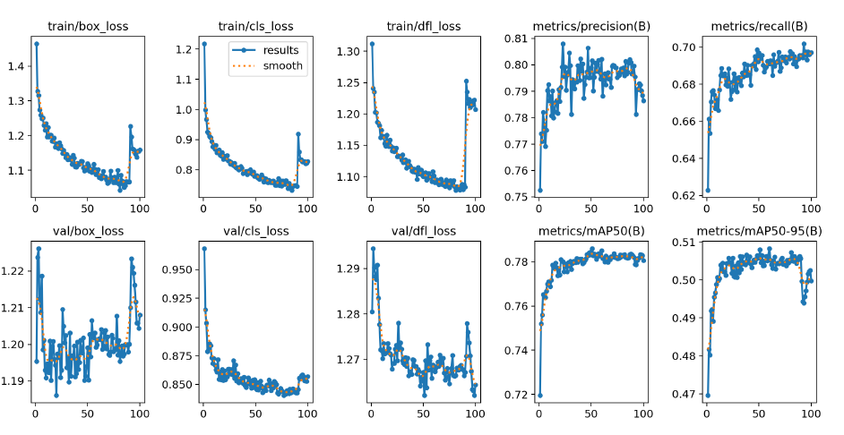
Relevant metrics

Slide 24
Relevant metrics
Recall (for small human data)
Recall: Number of positive samples (small humans) detected
Why: Since the data only contains small human annotations, this metric focus on the ability of the model to detect small humans
We expect recall to be lower (than when using the complete dataset), as we filter out the possible detections that the model is already comfortable with

Slide 25
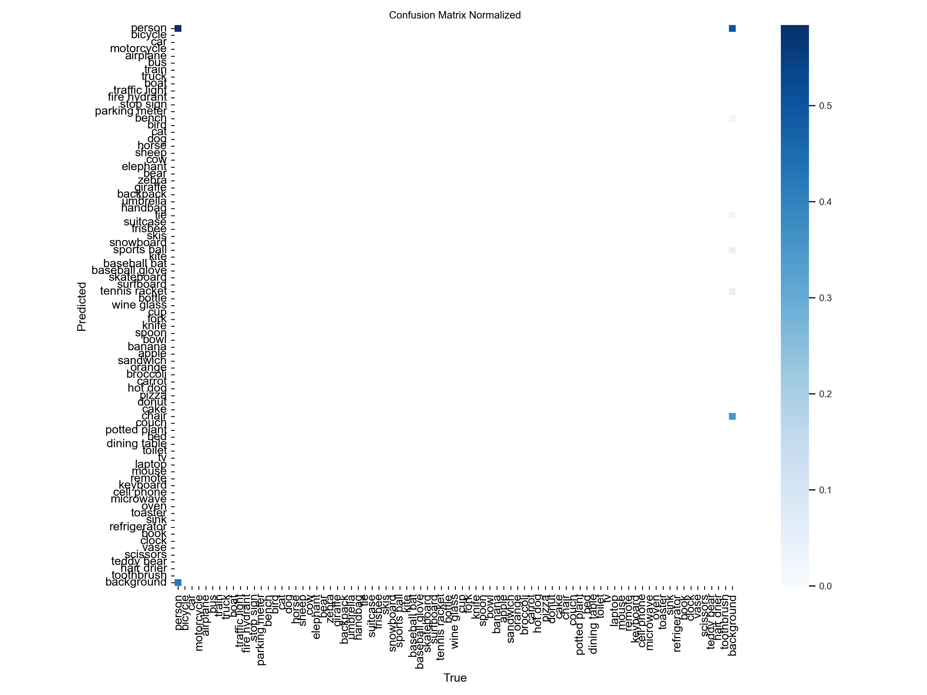

Optimization of parameters: single class

Slide 26
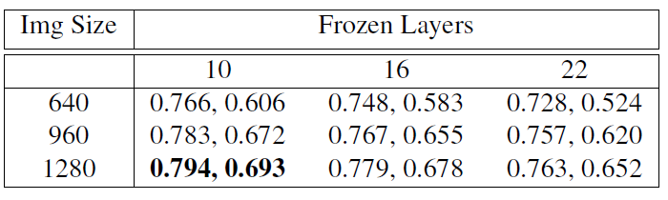
Optimization of parameters: freezing layers
Precision and Recall after 100 epochs. Results are averaged across the last 10 epochs for each run.
Ensuring Freezing using State Dictionaries
Best Values:
10 Layers (Backbone)
1280x1280 Image Size

Slide 27
Optimization of parameters: freezing layers

Slide 28
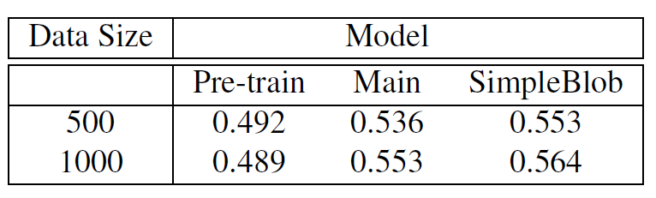
Model comparisons
Run both on the 500 and 1,000 images test set for small human datasets, obtaining the recall metric.
Pretrained: 6.8ms preprocess per image
Main (Finetuned without blob image): 7.0ms preprocess per image
SimpleBlob (Finetuned with blob image): 9.1ms preprocess per image

Slide 29
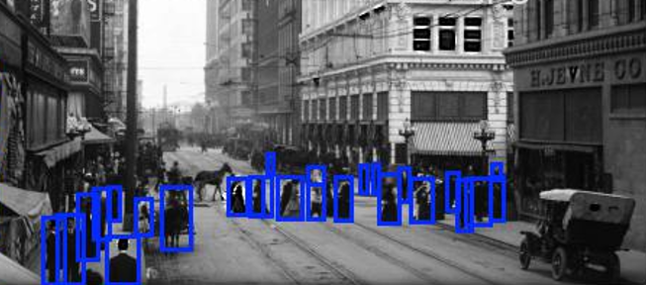
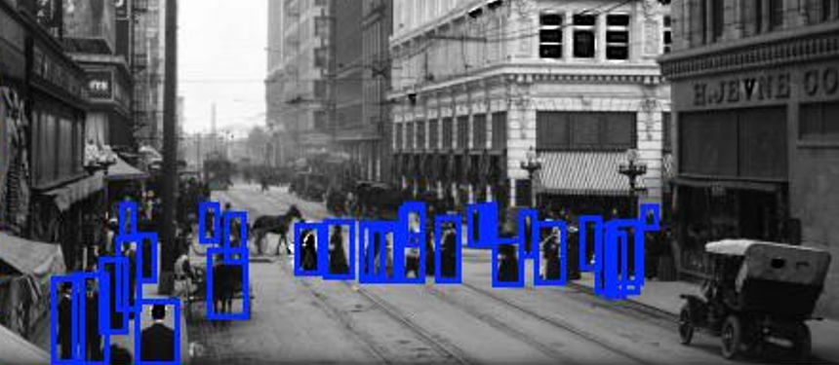
Model comparisons
Without Blob Injection
With Blob Injection

Slide 30
Iv. CONCLUSION

Slide 31
Conclusion: Injecting a simple blob detection layer results in a 1.1% improvement in detecting small humans
Future Work:
Trainable Blob Detection Layer
Processing Video Data

Slide 32
THANK YOU

Slide 33
